Slide 1
INTEGRATED BANKING SYSTEM
Use Case 7-Remittance Management
Team members-
1.Shivani Dasgupta
2.Saima Rashid
3.Srujan Sudam
4. Ayush Raj
5.Rugved Choudhary

Slide 2
CLIENT EXPECTATIONS
Consumer can
Add/modify his/her accounts in other banks
Add/delete his/her credit cards from other banks
Add/modify bank accounts of other people
Consumer can create an auto payment of any utility bill (IBS recognized Service Providers) of a constant amount at a specific date (like 1200 rupees for ACT internet on 5th of every month).
Bank representative shall approve and activate the added accounts or cards in the remittance section.

Slide 3

CUSTOMER
Add/Delete
the credit card details
Add/Modify
the beneficiaries’ details
LOGIN
Add/Delete
the Autopayment details for given service providers

Slide 4

Approve/Disapprove Credit Card and Beneficiary Requests
LOGIN

Slide 5
IN SCOPE
User can access the remittance facilities.
Auto payment
Beneficiary
Credit card
Scope for the bank representative to login, see the requests and approve or deny them.
Format validation.

Slide 6
OUT SCOPE
Addition to IBS Service Providers list.
Multiple accounts’ auto payment.
Validating the login details.
Logic behind bank representative’s.

Slide 7
Assumptions
Assumptions
User is already logged in.
No modification can be made by the bank representative in the user details.
Bank representative’s approval not required for auto payment.

Slide 8
ENTITY-RELATIONSHIP DIAGRAM

Slide 9
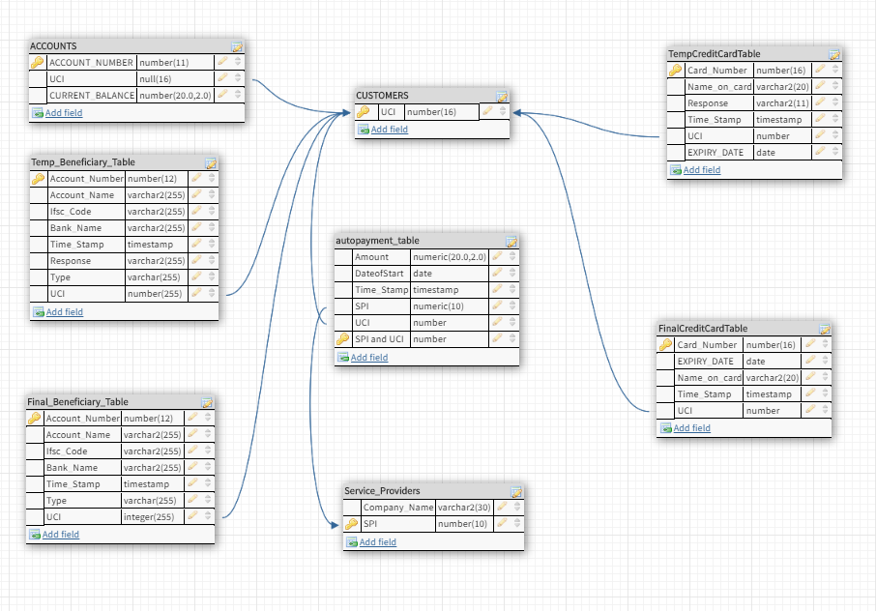

Slide 10
Thank You.

